Slide 1


SMILE
Smiling is the silent language
Of happiness
Ashis Kumar Rakshit 2317469 Minal Devpriya 2317654

Slide 2
INTRODUCTION
The Science of Smiles
Makes you feel happy by releasing brain chemicals
Shows joy and friendliness to others
Positive impact on mood and stress
How often do you find yourself smiling in a day ?
"You are not fully dressed until you wear a smile on your face"
~ Mahatma Gandhi

Slide 3


The Power Of Smile
The Power of Smile by 'The Yoga Institute'

Slide 4
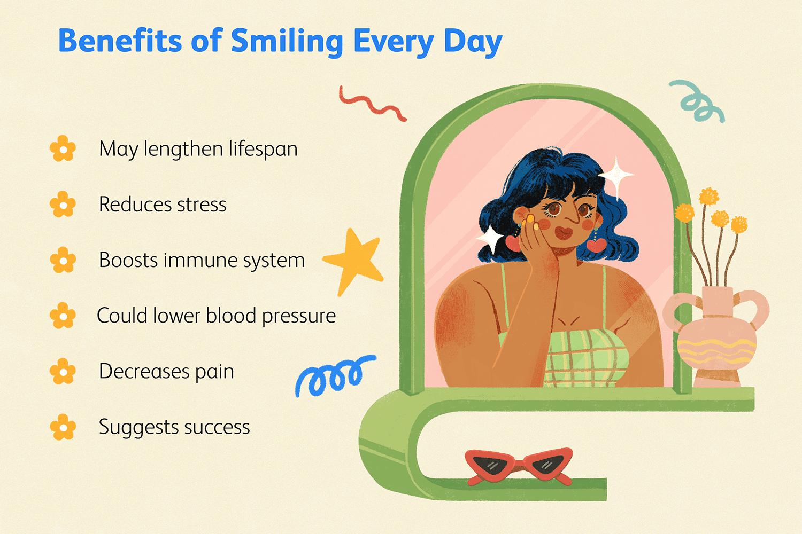
Smiles and Well-being
Smiling boosts your immune system
Smiling may help your immune system by reducing stress and promoting a positive outlook on health
Smiling lowers your blood pressure
Smiling isn't about happiness, it's a natural
way to lower blood pressure and keep
your heart happy.

Slide 5
Thank You

